Slide 1
Creative Business Solutions
Carloune Benedict

Slide 2
TABLE OF CONTENTS
01
04
LARIMER & CO
ADOBE CREATIVE CLOUD
02
05
SERVICES
STATS
03
06
ISSUES
FINAL POINTS

Slide 4
BRIDGE BUSINESS STRATEGY AND BRAND STRATEGY USING DATA-DRIVEN INSIGHT AND COMPELLING CREATIVE CONTENT
STORIES HAVE THE ABILITY TO BREATHE LIFE AND DIMENSION INTO EVENTS AND COMPANIES THAT MIGHT OTHERWISE BE FLAT.
COLLABORATION AND CREATIVITY IS WHAT WE STRIVE FOR
Notes:
CHANGE WORDS

Slide 5
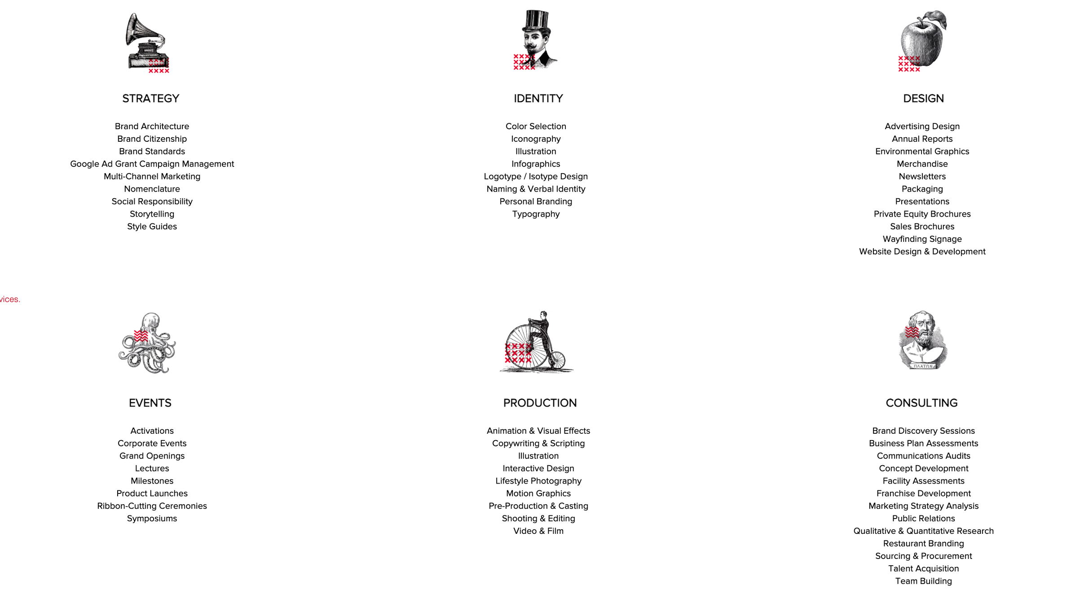

Slide 6
Issues
01
Finding a software that is compatible with a majority of the services we provide
02
Lack of efficient and seamless collaboration

Slide 8
CREATIVE CLOUD FOR TEAMS

Slide 9
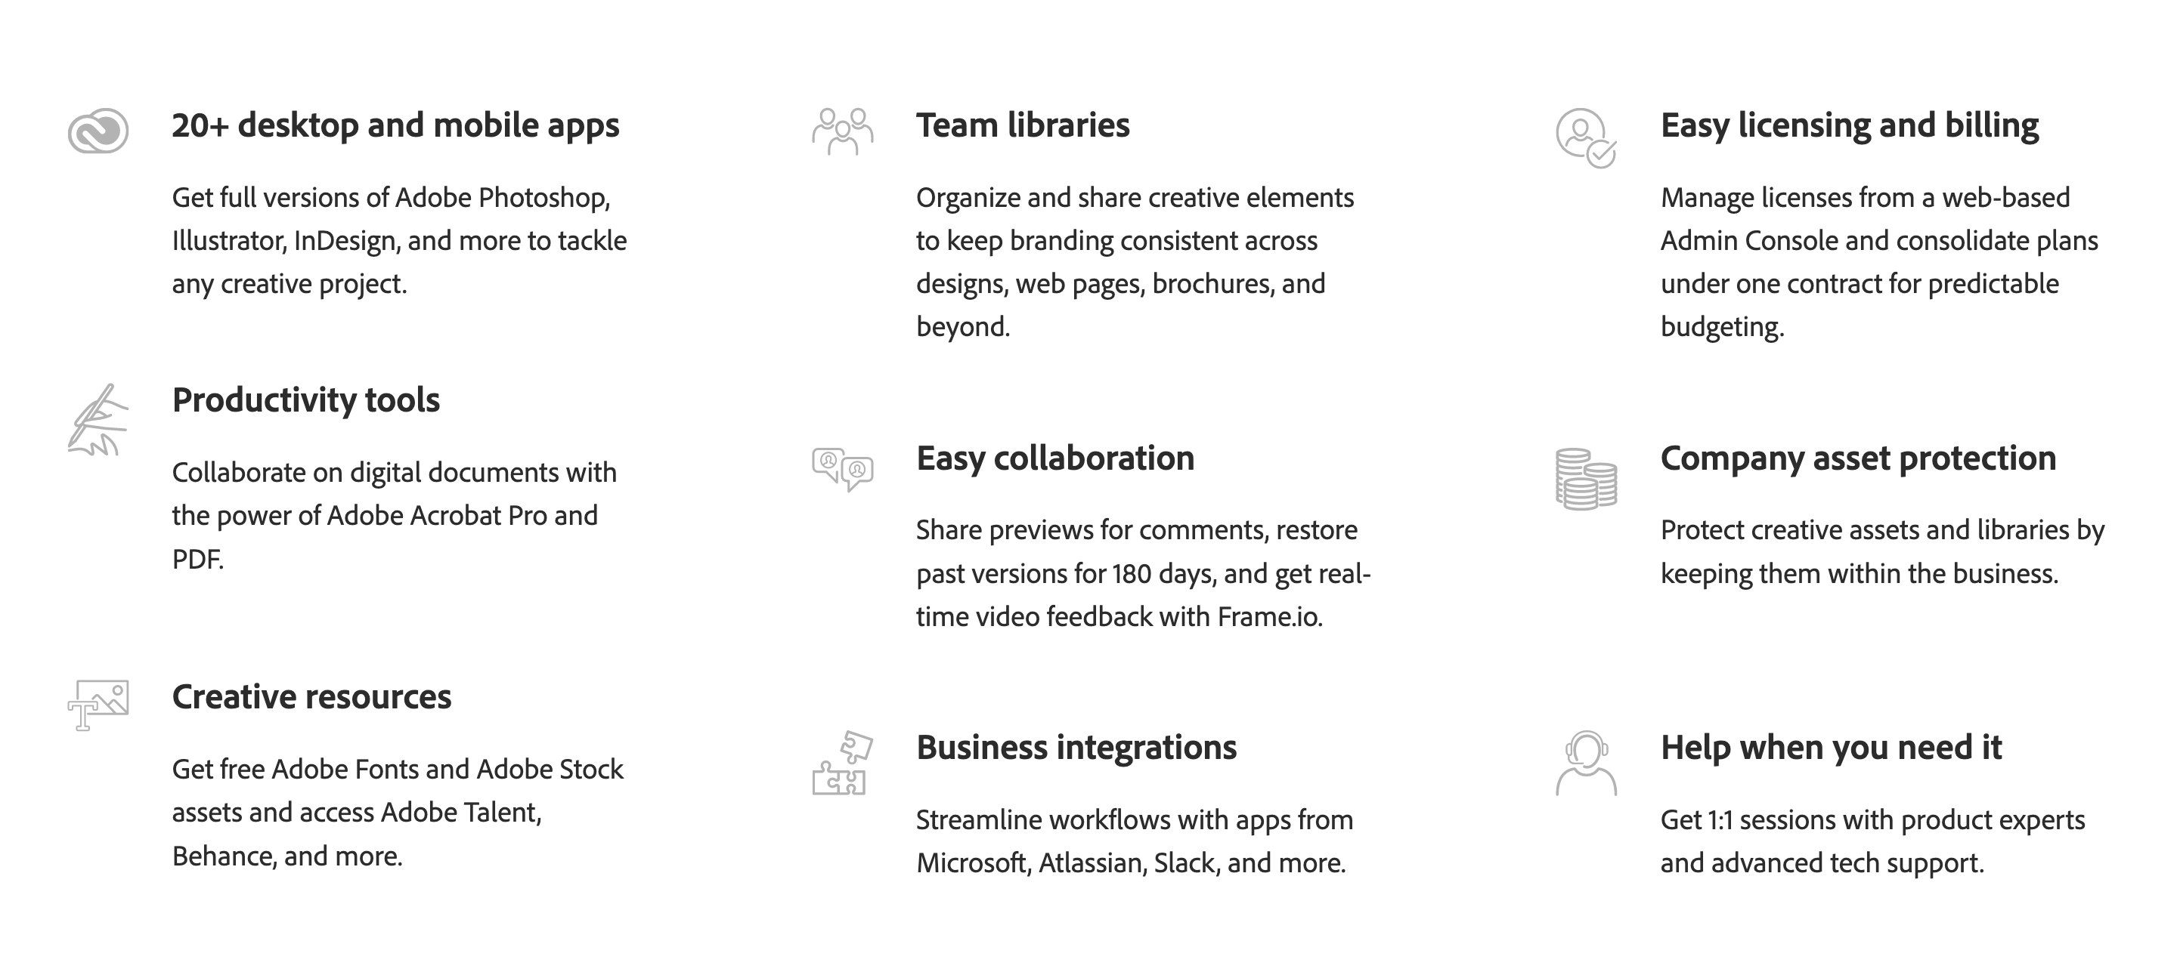

Slide 10
Adobe XD
After Effects
Premiere Pro
Photoshop
Acrobat Pro
InDesign
Illustattor
Lightroom

Slide 13
ALTERNATIVES

Slide 14
35%
of organizations have noticed an increase in productivity creative projects
Individuals saved
2.9 Hours
STATS
Teams
saved
3.6 Hours
41%
have noticed a better streamline in team workflows

Slide 15
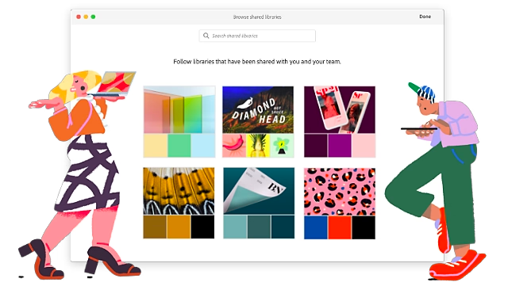
FINAL POINTS
Have Every Tool At Our Disposal
Collaborate Efficiently And Effectively
Maintain Company Control.

Slide 16
THANK YOU

